Slide 1

NLP Analytics on IMDB Reviews
CS777 Term project
- Atharva khaire, Parita Danole

Slide 2
Agenda
Introduction
Dataset
Methodology
Implementation
Analysis
Results
Conclusion

Slide 3
introduction
Sentiment Analysis
IMDb Reviews
Apache Airflow
AWS
Notes:
Sentiment analysis is the use of natural language processing, text analysis, computational linguistics, and biometrics to systematically identify, extract, quantify, and study affective states and subjective information. It is the process of analyzing digital text to determine if the emotional tone of the message is positive, negative, or neutral. Companies have large volumes of text data like emails, customer support chat transcripts, social media comments, and reviews that need to be analyzed to determine opinions about their product, service or idea.
The Internet Movie Database (IMDb) is an online database containing information and statistics about movies, TV shows and video games. IMDb provides the review feature as a forum where users can freely express their opinions about movies or TV shows. Apache Airflow is an open source tool used for complex task orchestration. It is like a very smart scheduler that knows when to run tasks, how to run them and in the correct order.

Slide 4
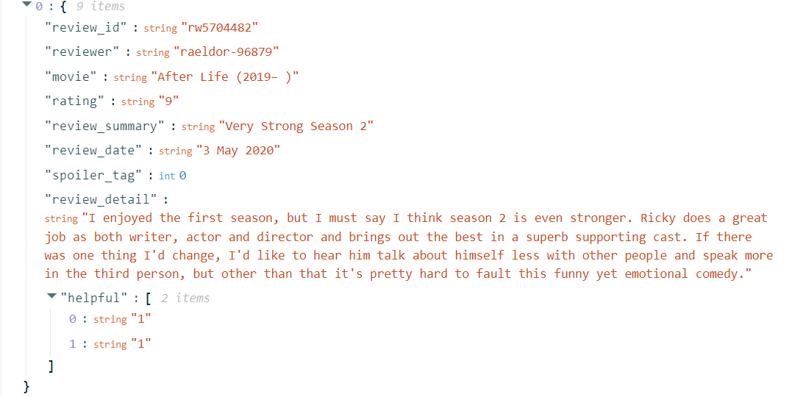
Dataset
Kaggle
5,571,499 records
Notes:
review_id: It is generated by IMBb and unique to each review
Reviewer: Public identity or username of the reviewer
Movie: It represents the name of the show (can be - movie, tv-series, etc.)
Rating: Rating of movie out of 10, can be None for older reviews
review_summary: Plain summary of the review
review_date: Date of the posted review
spoiler_tag: If 1 = spoiler & 0 = not spoiler
review_detail: Details of the review
Helpful list: [0] people find the review helpful out of list[1]

Slide 5
methodology
Extracting TF-IDF features
Classification models
Regression models
Kmeans clustering
LDA
Notes:
TF-IDF features: Tokenization, Stop words removal, term frequency hashing, inverse document frequency Classification models: Logistic regression, naïve bayes, decision tree, random forest Regression models: Linear regression, decision tree regression, random forest regression, gradient boosted tree regression K-means clustering is a well-liked unsupervised machine learning method for organizing reviews into clusters according to textual content similarities. K-means recognizes innate structures in the data, classifying reviews into clusters without prior knowledge of the categories, in contrast to supervised learning techniques that require labeled data. Latent Dirichlet Allocation (LDA) is an advanced unsupervised machine learning method for identifying abstract concepts in the textual data.

Slide 6
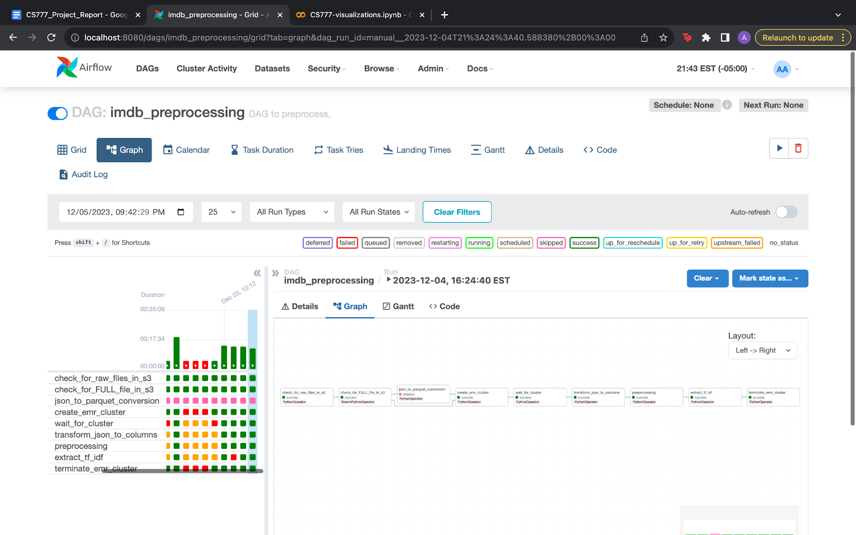
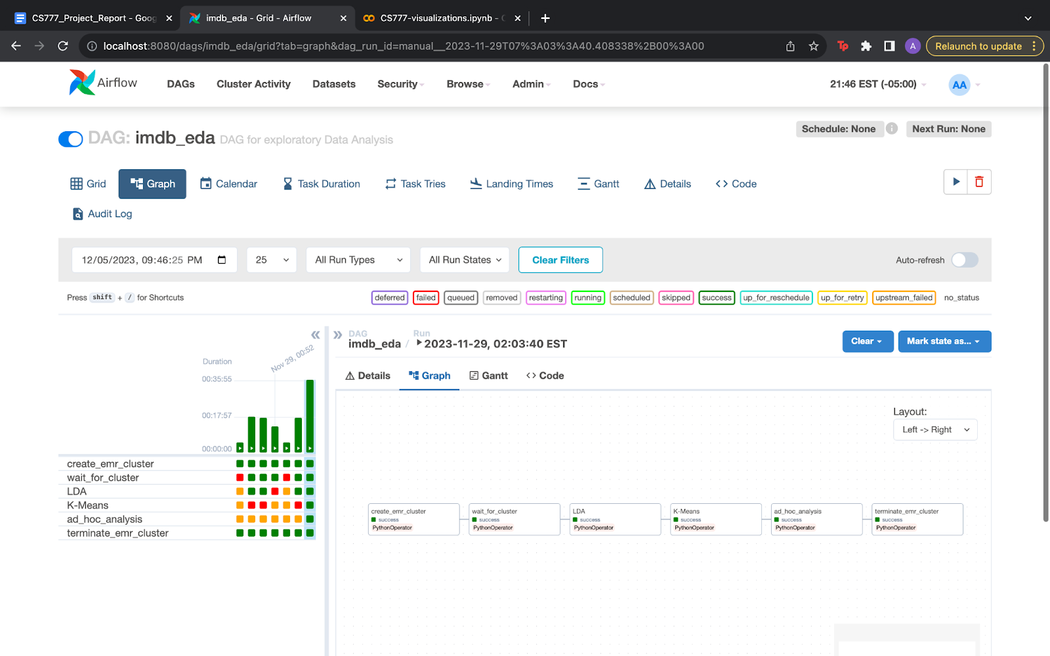
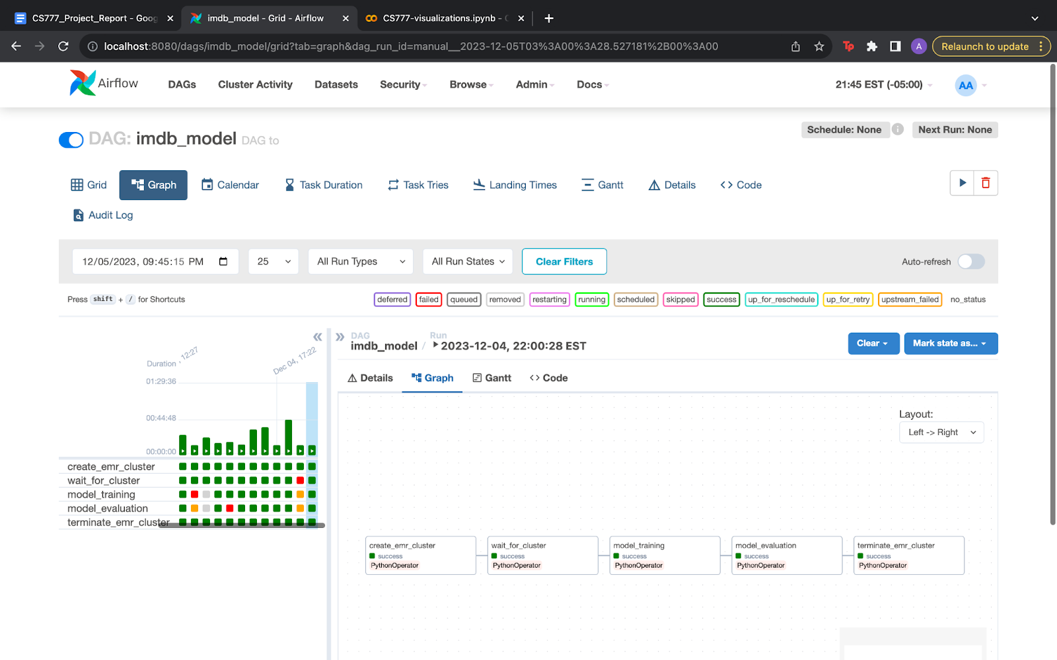
implementation
IMDb eda DAG
IMDb preprocessing DAG
IMDb model DAG

Slide 7
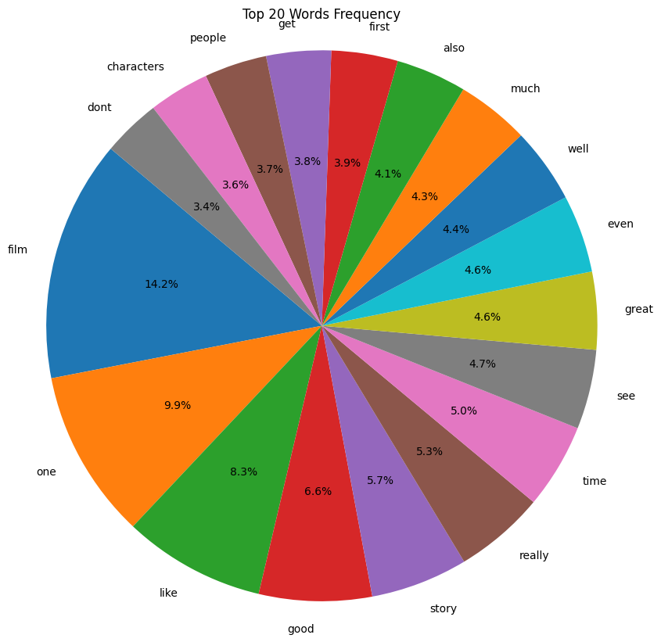
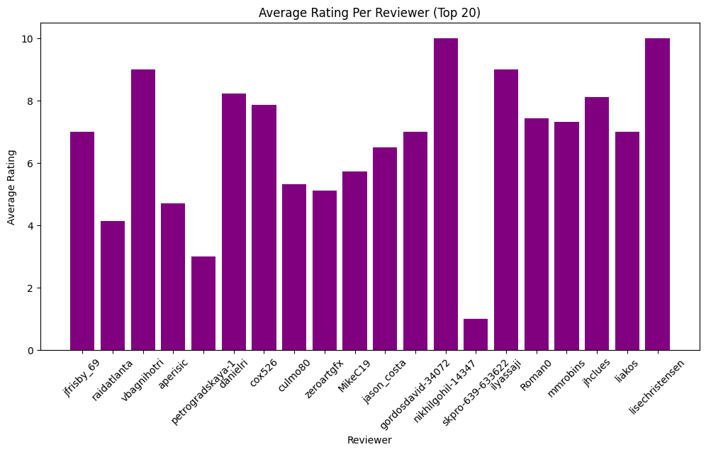
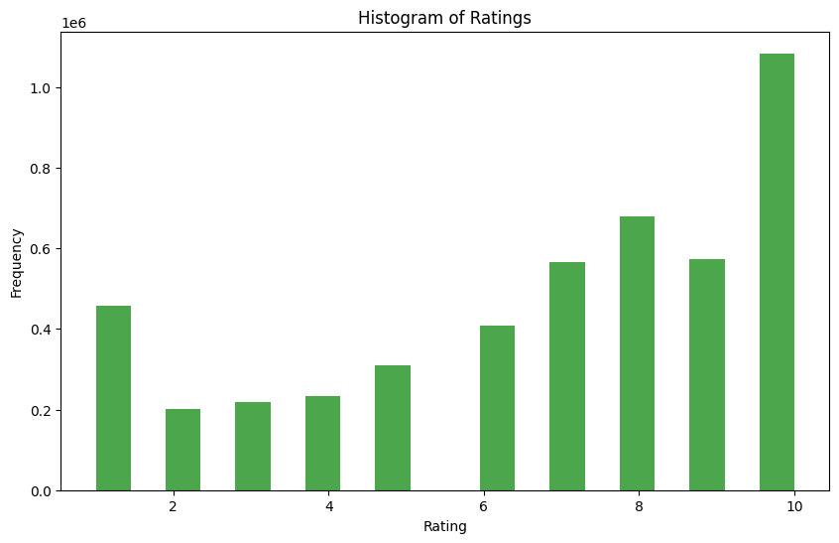
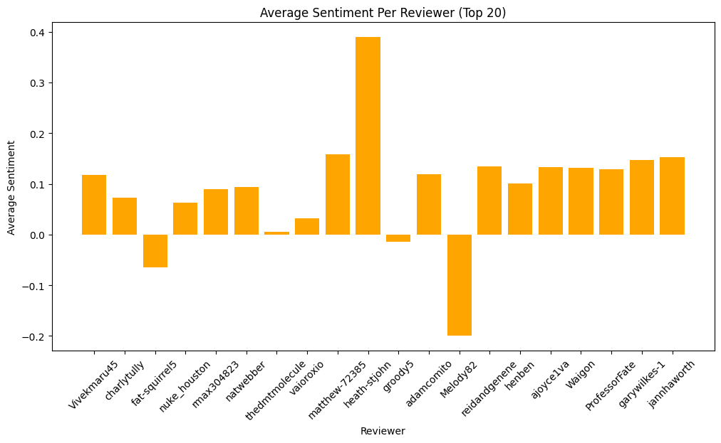
analysis

Slide 8
results
Model | Training Accuracy (in %) | Testing Accuracy (in %)
Logistic Regression | 69.3 | 68.9
Random Forest Classification | 92.7 | 91.4
Naive Bayes | 15.1 | 9
Decision Tree Classifier | 65.5 | 50.6
Model | Training RMSE | Testing RMSE
Linear Regression | 0.952 | 1.066
Random Forest Regression | 0.505 | 0.678
Gradient Boosted Tree Regression | 0.7 | 0.65
Decision Tree Regression | 0.798 | 0.791

Slide 9
conclusion
Gradient Boosted Tree Regression has best RMSE of 0.65
Random Forest Classification has best accuracy of 91.4%
Classification models are better suited for this data

Slide 10
Thank you!

